Slide 1
Face Replacement
CIS581- Computer Vision and Computational Photography
Project4 – Part B
Team 26
Pruthvi H R
Urja Nadibail

Slide 2
Overview
Methodology
Learnings and improvements
Results

Slide 3
Methodology
Face detection
Target Face Detection and Keypoint Location
Face warping: TPS warping
Face replacement : Polygon
Histogram equalization: Adjust contrast
Image blending - Laplacian

Slide 5
START: Read frame from the input video buffer
Face detection and key point localization
TPS warp the polygon hull of the source face with target face
Blend the target with the source image using a Laplacian or Gaussian blur
Adjust contrast using Histogram equalization
Get the polygon hull of the source face
END: Write the frame to the output video buffer

Slide 6
Learnings and Improvements
Consider ‘replacement-face’ based on
orientation
illumination
shape of the face.
contrast
Different types of blending for different scenarios.

Slide 7
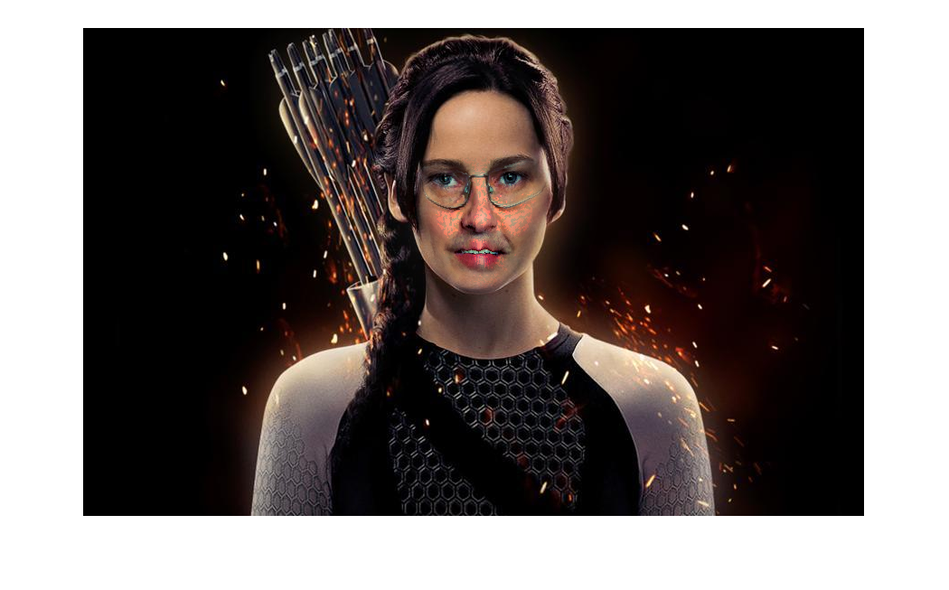

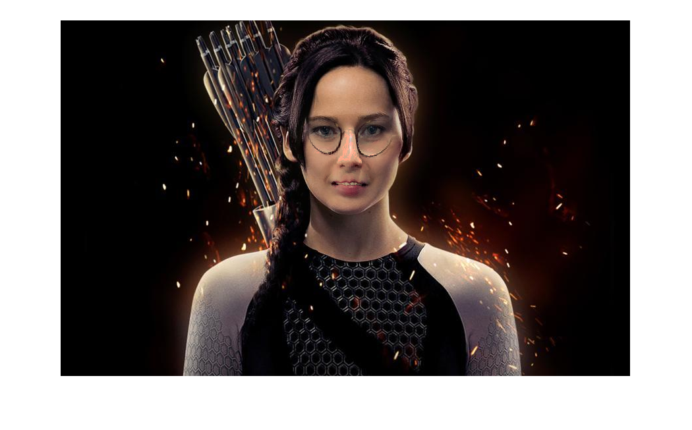
Dissimilar faces

Slide 8
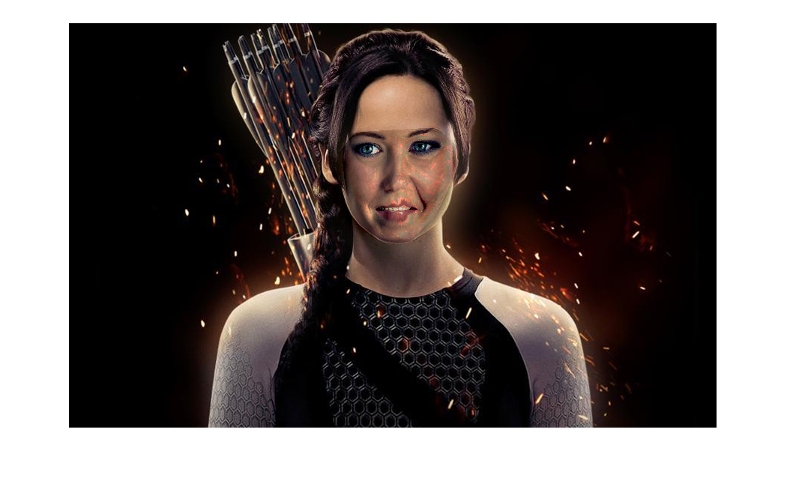


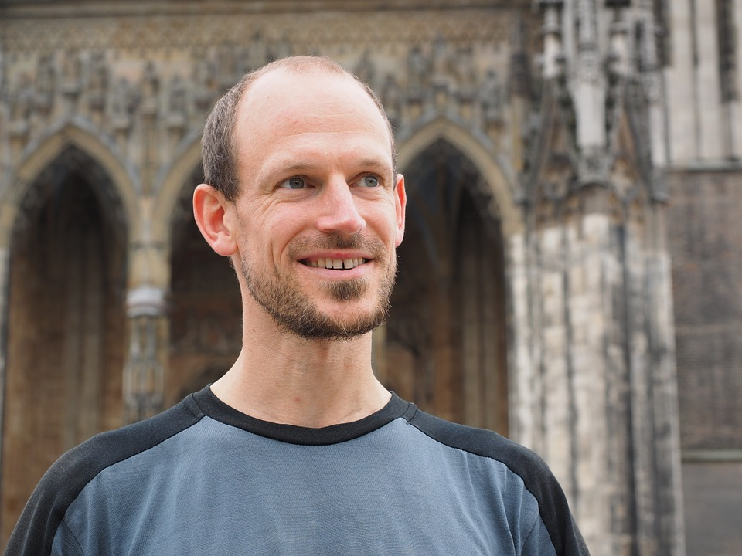
Left orientation with Gaussian blending
Replacement face with left orientation
Replacement face with right orientation
Right orientation with Gaussian blending

Slide 9
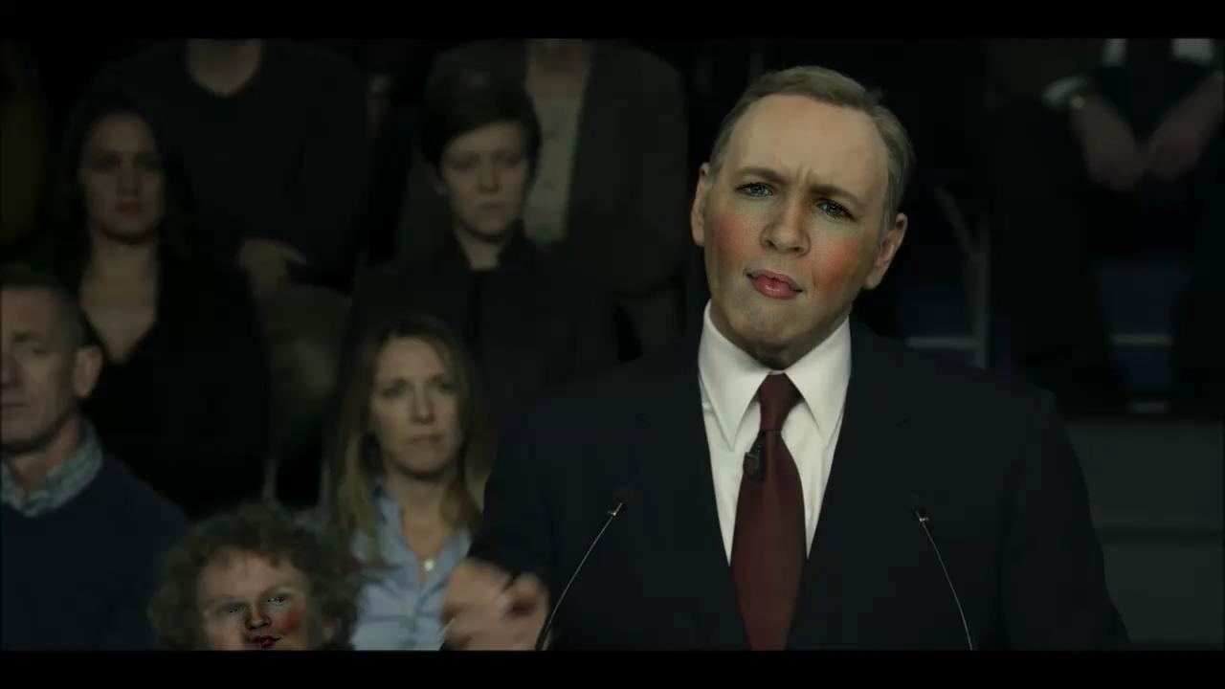
Results: Easy video1 with Laplacian blending

Slide 10
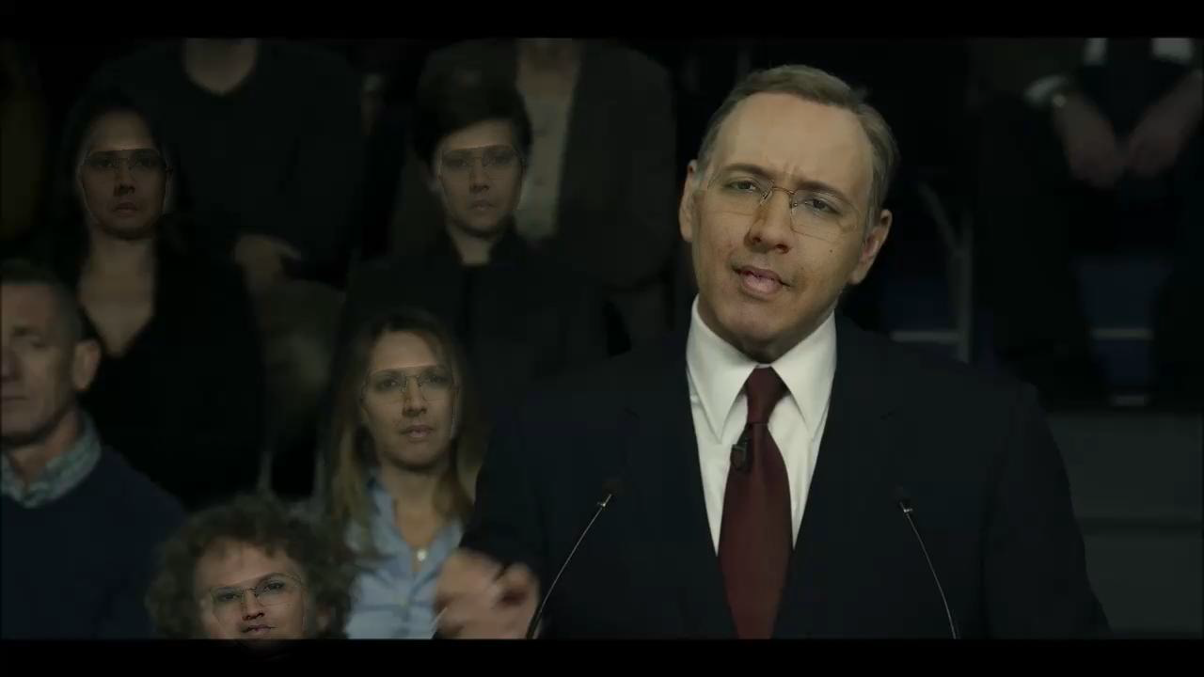
Easy video1 with Gaussian blending

Slide 11

Easy video2

Slide 12

Easy video3

Slide 13
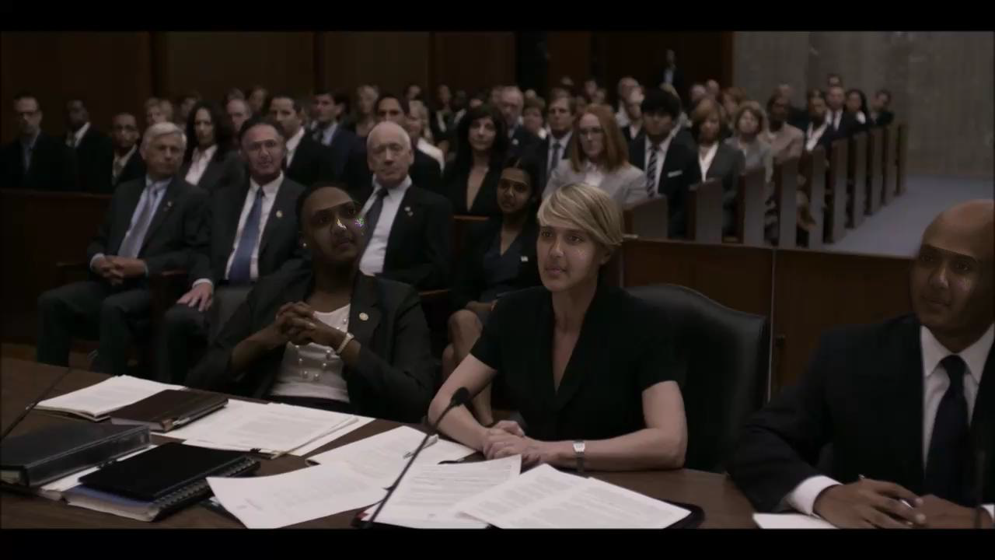
Medium video1

Slide 14
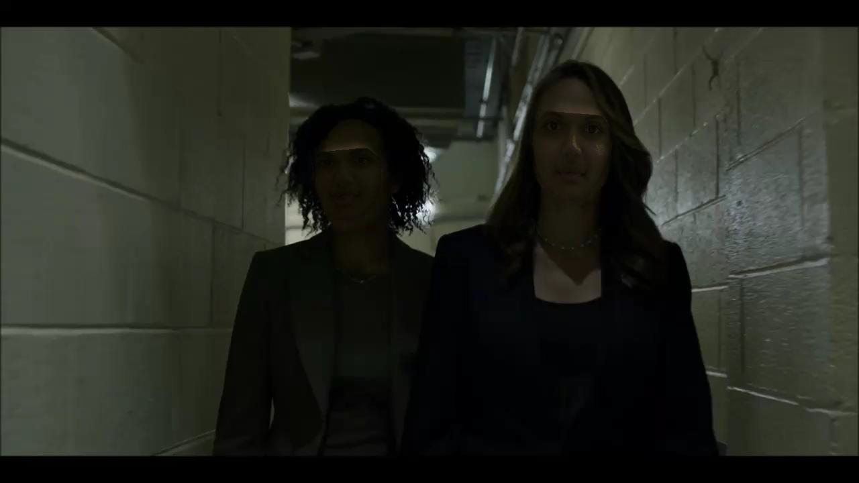
Hard video

